Slide 1
Chidambaram’s Challenge
Sunil Jain
Presentation to ICICI Venture Funds Management Company Ltd
Gurgaon
February 16, 2013

Slide 2
First, a quick overview of the macro numbers
The trending down of GDP, consumption, investment, S-I gap and its impact on the current account deficit and the rupee and so on
Essentially, govt destroyed GDP growth
Is govt serious about fixing this?
I’m actually optimistic

Slide 3
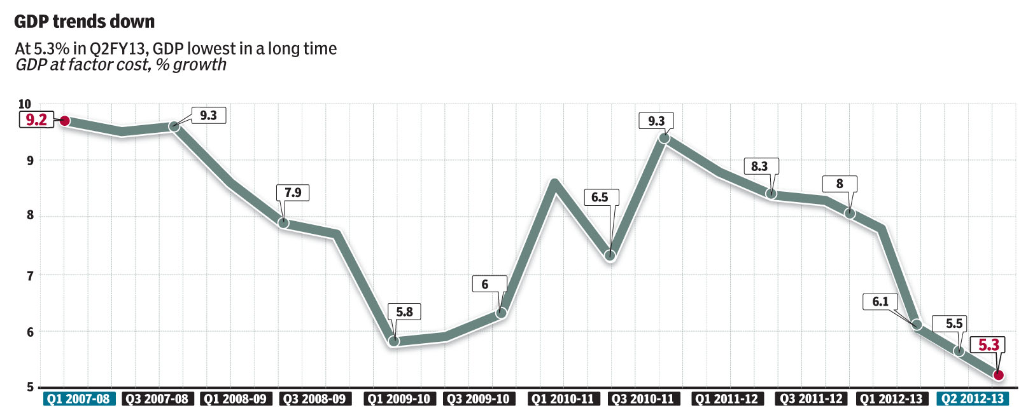

Slide 4
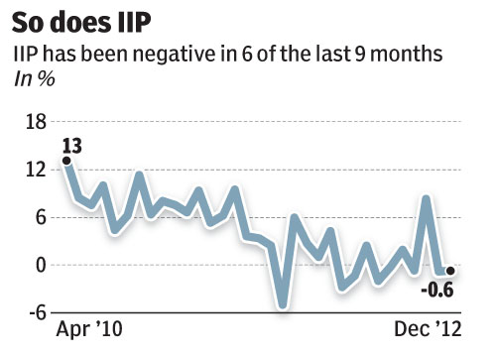

Slide 5
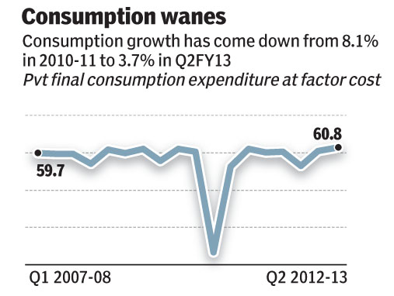

Slide 6
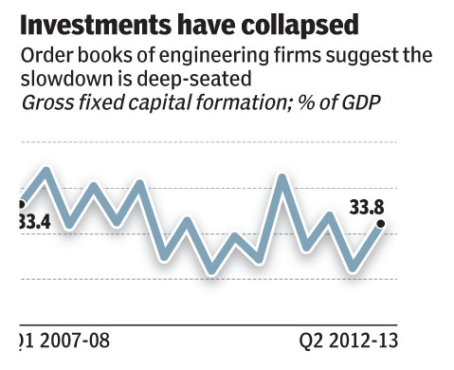

Slide 7
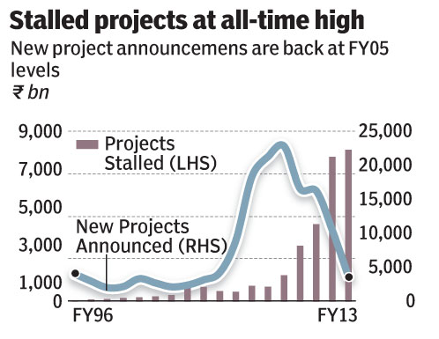

Slide 8
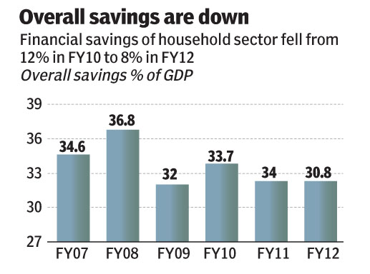

Slide 9
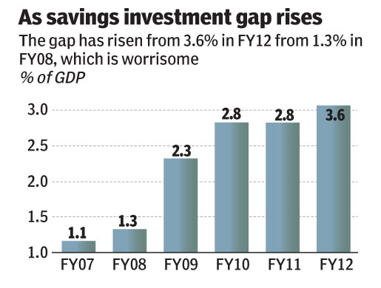

Slide 10
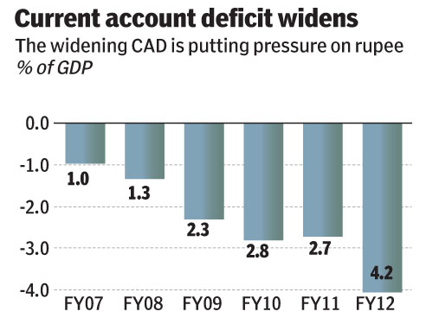

Slide 11
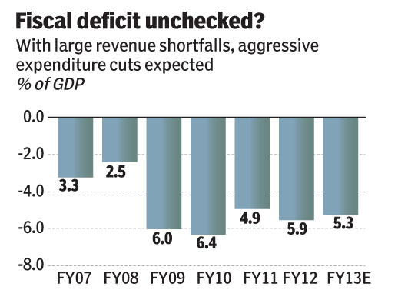

Slide 12
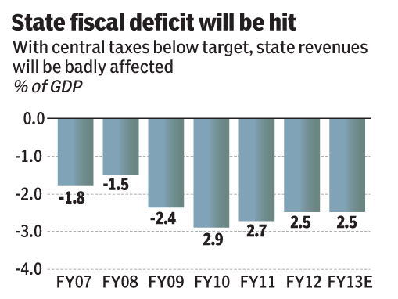

Slide 13
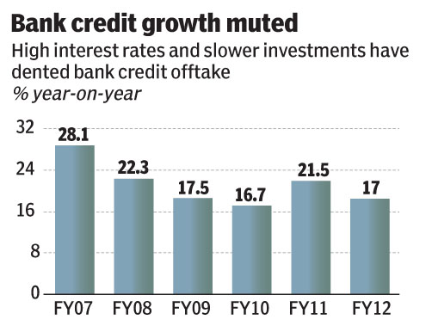

Slide 14
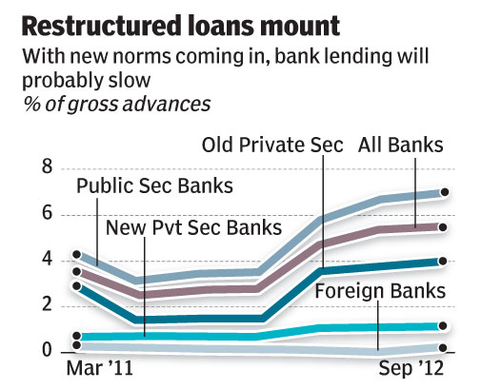

Slide 15
You’re familiar with the story so far
You know the govt has made a lot of progress after P Chidambaram came back as FM
But it’s also gone back to being anti-business … look at the Shell and Nokia cases
Question is: Where are we on balance?

Slide 16
Much of the current optimism is based on
(a) RBI cutting interest rates
Making new investments viable
Sensex looks more attractive
Investment levels rise
(b) Govt clearing projects (let’s just go back to the slide on stalled projects … clear a few, and the IIP cycle will change immediately)
(c) Huge liquidity … India got $22bn FII in 2012 and $8bn in 45 days of 2013

Slide 17
But with capacity utilisation at 73%, fresh investments will take time (GMR-types even walking out)
Most important, investment levels started falling long before RBI started its interest-rate increase cycle
India Inc is HUGELY over-leveraged, can’t even raise equity, so will take time to work off the fat
Little doubt rates cuts will raise profits

Slide 18
WHAT WILL HELP?

Slide 19
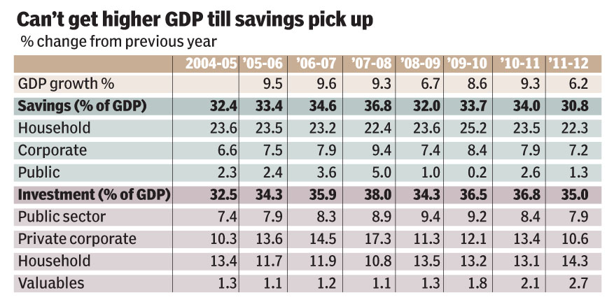

Slide 20
Other policy initiatives
FDI in retail
Raised railway fares
Raising bulk diesel prices
Started on Aadhar
Slashing expenditure … FY14 budget to be same size as FY13 is what our chaps say … I hope they’re right!
CCI process has started, hesitatingly

Slide 21
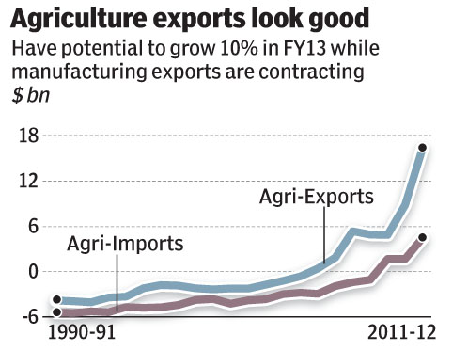

Slide 22
Corporate Sector doesn’t trust GoI
Nokia
Shell
85% jump in Transfer Pricing cases in FY12
Vodafone
Antrix Devas
Lavassa
UTI TRowePrice
Telecom being killed
Education being killed … ditto for skilling which was meant to be big new hope
…

Slide 23
Food Security Bill
Reservations
Lack of clarity on retrospective taxation
Retrogressive legislation

Slide 24
CAD never been worse. Just a fourth of it is financed through FDI, means GOI needs to be a lot more responsible than ever before
Shome Committee
States raising power prices + money in system due to restructuring package
Telecom close to dying, so will have to fix
Global growth is returning … means risk-on
Distress sales of assets …Delhi-Gurgaon
So what are the hope buckets?

Slide 25
Recovery speed is really the question
Savings increase will take time
Govt response won’t be quick either (no permission to Cairn to explore more even though govt gets $15bn on NPV basis … CCI process shows major goof-ups in NELP)
India Inc is way too leveraged, so even if MoEF gives all clearances today, it can’t take on too many new projects (GMR got out because of leverage, not because of MoEF)

Slide 26
Thank you

